Slide 1
Puzzle Game 3d
By
(I)Yash Patel (11CE091)

Slide 2
Objective
Puzzles are often considered to not be games at all.
Video games that require mental skill as well as, or instead of, dexterity and quick reflexes.

Slide 3
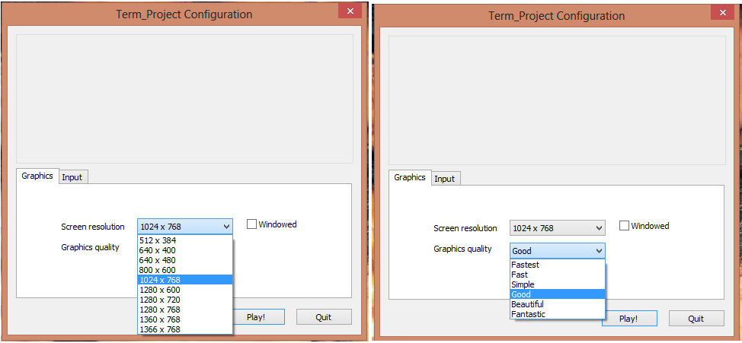
Controls

Slide 4
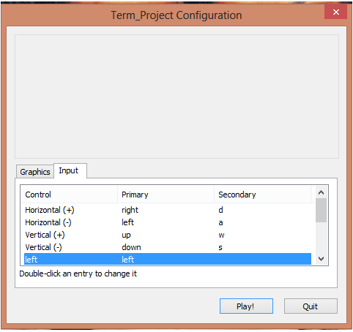
inputs

Slide 5
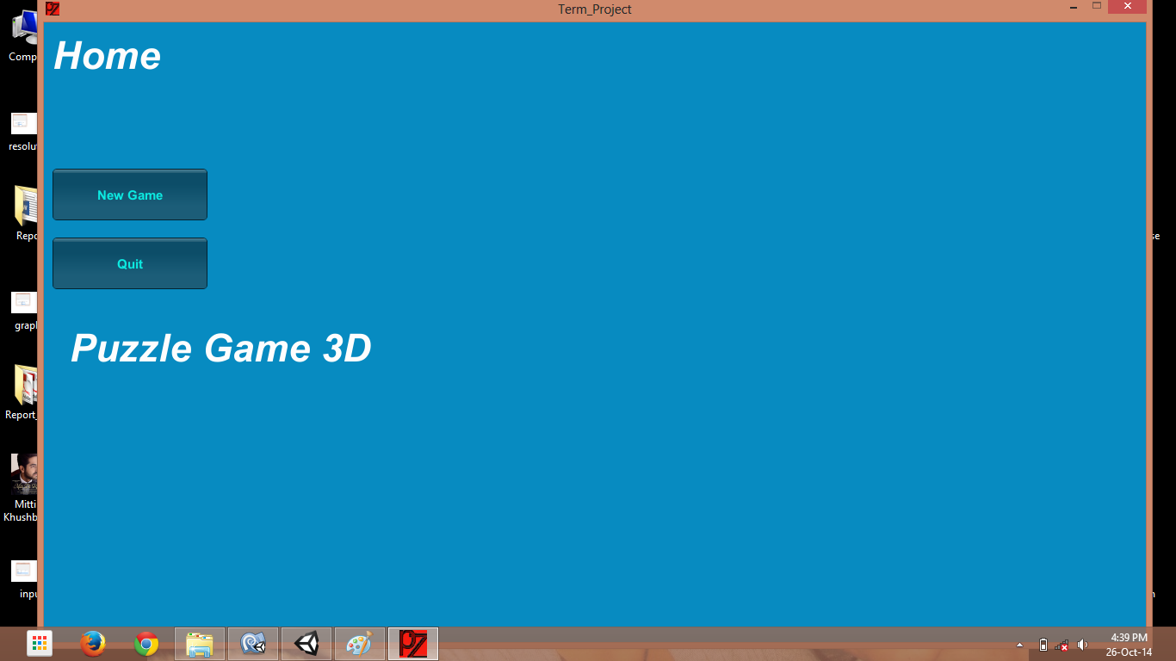
Home Screen

Slide 6
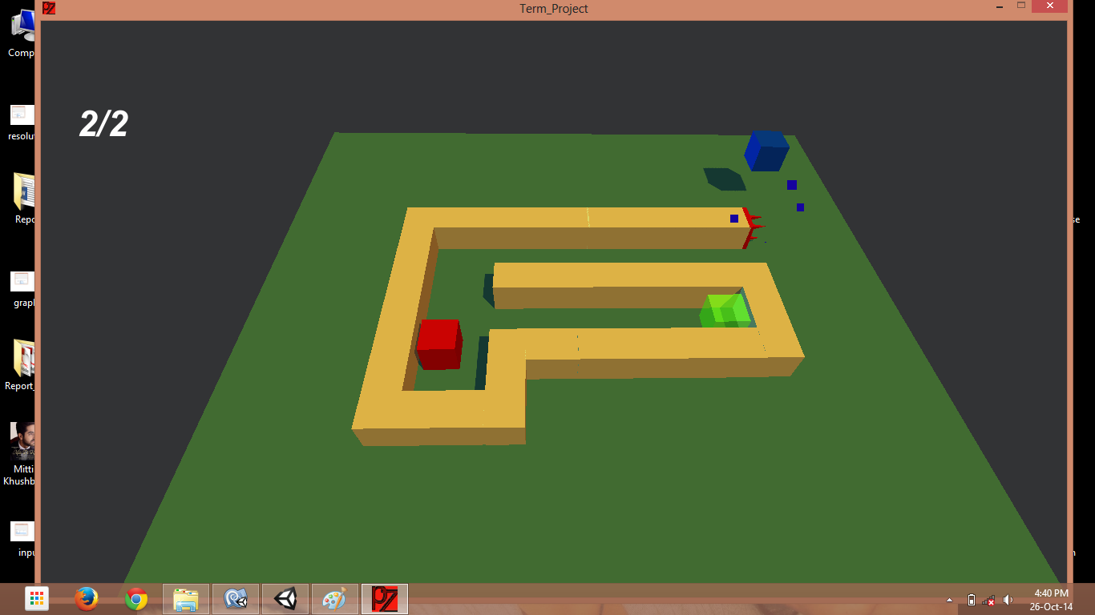
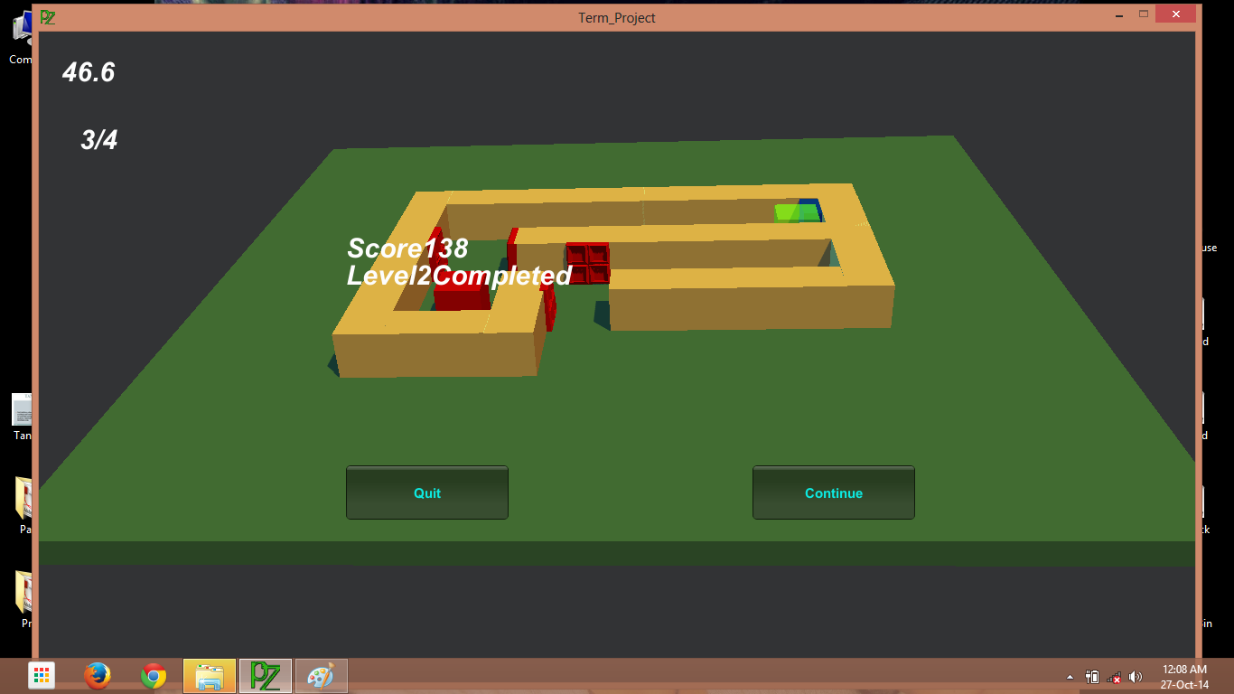
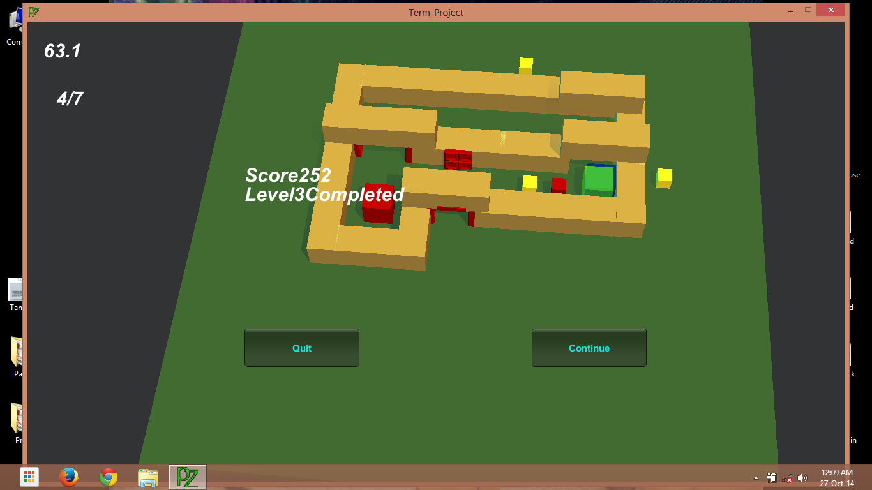
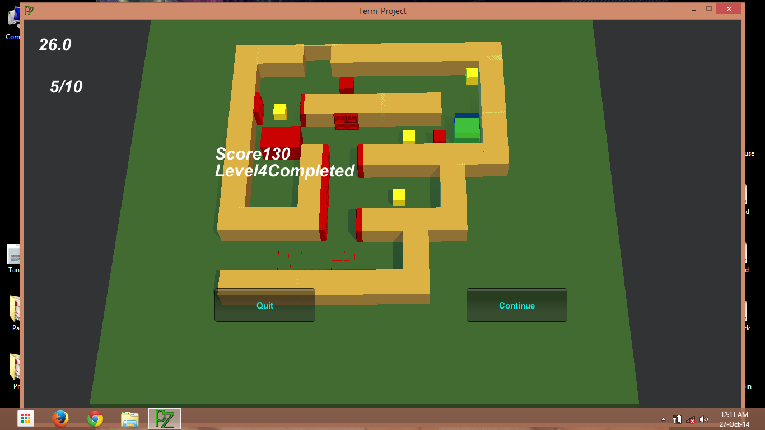
Levels

Slide 7
Benefits
Physical skills -- from holding puzzle pieces and turning them until they fit
Cognitive skills -- as they solve the problems of a puzzle
Emotional skills -- they learn patience and are rewarded when they complete the puzzle

Slide 8
Thank You…….

